Slide 1
Yeast Feast: Finding glucose in food

Slide 2
Biology, Homeostasis, and Type 2 Diabetes
Yeast Feast: Finding glucose in food
Entrance Activity:
What is glucose? Where does glucose come from in our diets?
Think about….
What foods/drinks contain glucose?
Where do other sugars come from?
What is glucose used for in the body?
Glucose can be described as both a fuel and a toxin. How can something so good also be so bad?

Slide 3
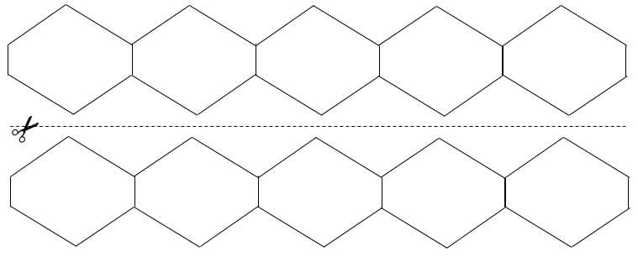
Where is glucose in food? Part I
Option 1
Paper doll method
accordion paper
cut into folded strips
snip off corners
unfold
OR
Option 2
Shortcut—
photocopy template
cut along line
tape end-to-end

Slide 4
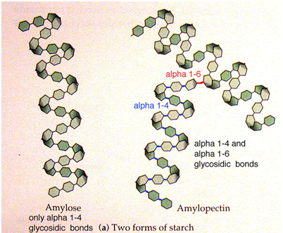
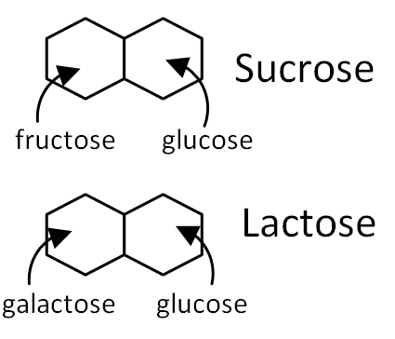
Glucose
Polysaccharides
Disaccharides
Monosaccharide
Starch such as potatoes, wheat, corn, rice, cassava, sorghum
Fiber, such as indigestible cellulose
Table sugar, milk sugar
Including glucose, which is the primary energy molecule for the body.
Notes:
Teacher note: Slides 1 -9 are introductory slides to be shown before the activity begins.

Slide 5
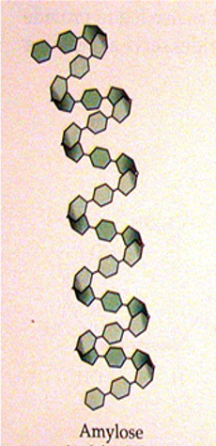
Enzymes are the “molecular scissors” that break the large carbohydrates and sugars apart so that the body can get energy from the individual units.
The enzyme that cuts sucrose is called sucrase (sometimes invertase)
The enzyme that cuts amylose is called amylase
The enzyme that cuts lactose is called lactase
Which molecule(s) will get broken down fastest?

Slide 6
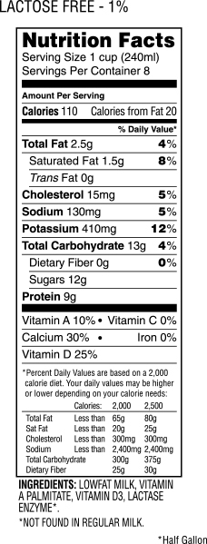
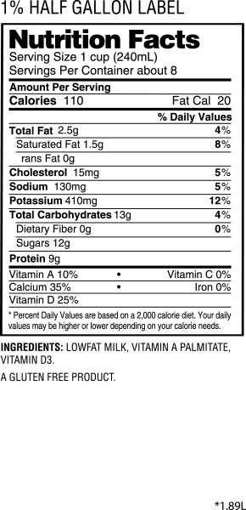
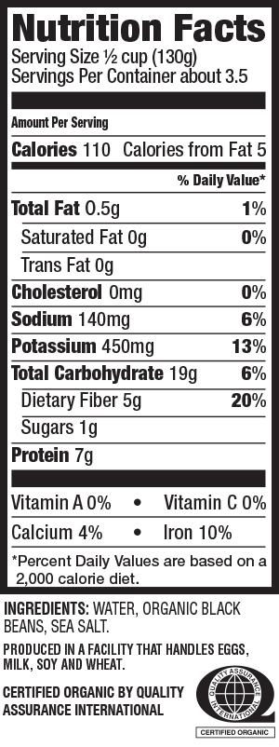
BLACK BEANS

Slide 7
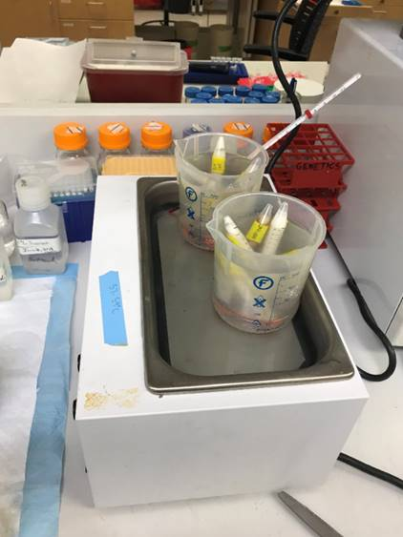
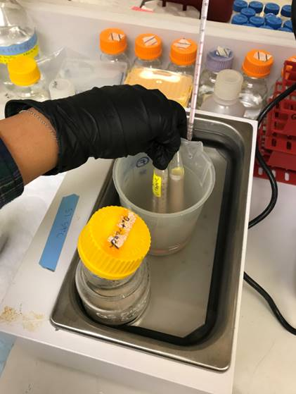
Yeast Feast

Slide 8
What does glucose have to do with type 2 diabetes?
Type 2 diabetes develops when blood glucose levels are too high for too long. The body is not maintaining blood glucose within a healthy range.
Homeostasis allows organisms to maintain balance (stability) even as the external environment changes.
You may have high blood glucose levels after eating a large meal, or low blood glucose levels between meals. Your body responds to how often you eat and what you eat in order to keep blood glucose levels within a healthy range.

Slide 9
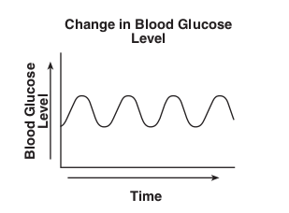
Which graph best represents healthy blood glucose levels?
A
B
Notes:
Graph A represents a feedback mechanism that maintains homeostasis. This keeps blood glucose levels within a range. It is okay for blood glucose levels to go up (within a range) as long as they come back down.

Slide 10
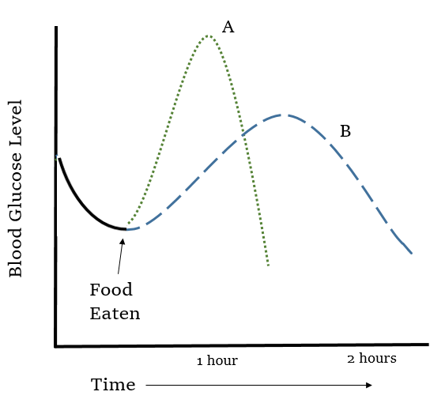
Glucose responses for two different foods.
Notes:
What kind of food might be represented by Line A?
A sugary food or drink the releases glucose into the blood quickly, such as soda, candy, or cookies. White bread, white rice and other starches without much fiber can also release glucose quickly.
What kind of food might be represented by Line B?
A food with a higher fiber content, such as whole grains, whole fruit, and legumes.
How would insulin release be different for Lines A and B? Line A foods would trigger more insulin.

